Slide 1
Syth Ryan
Saturation Bit Counter Simulator: Simulator the Effects of Varying Counter Sizes

Slide 2
Unique
Each program is unique
Each program could benefit from a unique size of Saturating bit counter.
Some need more tolerance than others

Slide 3
Predicting the future
Correct predictions greatly increase speed
Incorrect predictions take even longer than normal execution
Even small increase in accuracy should improve speed.

Slide 4
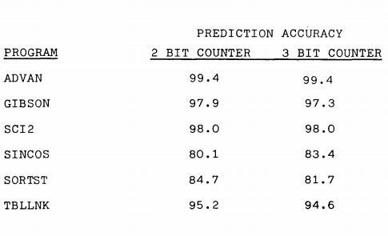
Saturating Bit Counter
More bits = More tolerance to change
On average accuracy doesn’t increase past 2 bits
Some have the possibility of benefitting from more bits(SINCOS).
Figure 2: Comparison of 2 bit and 3 bit counter’s accuracy for various programs [1]

Slide 5
Simulator
Microsoft Visual Studio 2013
C
Preliminary development (testing feasibility)
Runs theoretical simulation with prior branch knowledge

Slide 6
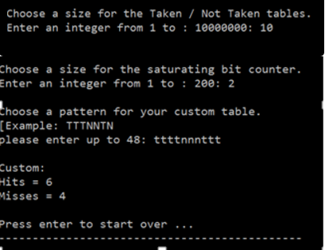
Simulator : Interface
T/NT Table size 1 -> 10 million
Bit counter size between 1 -> 200
Pattern 1->48 t or n/ T or N (repeats)
Displays correct and incorrect predictions.

Slide 7
Results
Similar to Smith’s [1] past 2 bits we don’t see much improvement.
Some cases did show improvement. As shown here.

Slide 8
Future work
Unsure if its feasible to continue on this
Pre run algorithm would be difficult to create.
Results did show improvement but not a lot.

Slide 9
References
[1] A study of branch prediction strategies In ISCA '81: Proceedings of the 8th annual symposium on Computer Architecture (1981), pp. 135-148 by James E. Smith
[2] "Branch Prediction 2bit Saturating Counter-dia." File:Branch Prediction 2bit Saturating Counter-dia.svg. Wiki Media Commons, 31 July 2011. Web. 12 Dec. 2015.
[3] Loh, Gabriel H., Dana S. Henry, and Arvind Krishnamurthy. "Exploiting Bias in the Hysteresis Bit of 2-bit Saturating Counters in Branch Predictors." Journal of Instruction-Level Parallelism 5 32nd ser. 5.1 (2003): n. pag. Web. 12 Dec. 2015. <http://homes.cs.washington.edu/~arvind/papers/jilp.pdf>.

